Slide 1

CLARIN ERIC & CLARIN-IT
humanities and social sciences, and beyond
Monica Monachini, National Coordinator
Notes:
We will move to another infrastructure, CLARIN, the Common Language Resource Infra devoted to all disciplines that have as object of study the language (or use language as vehicle of communication]. [CLARIN’s mission is to create and maintain an infrastructure for the sharing, use and sustainability of language data and tools to support researchers in the humanities and social sciences.

Slide 2
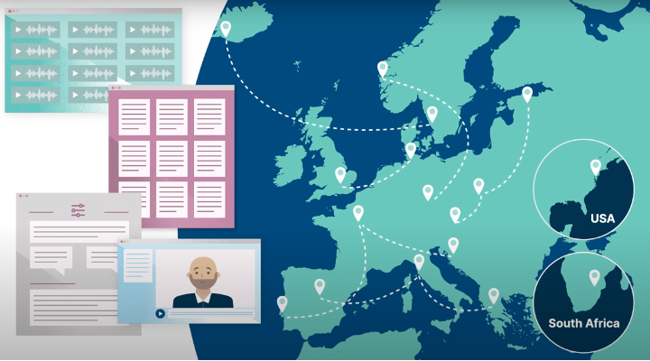
ESFRI ERIC since 2012
Landmark since 2016
easy and sustainable access for scholars in the humanities and social sciences
digital language data in written, spoken, video or multimodal form​
advanced tools to discover, explore, exploit, annotate, analyse or combine them, wherever they are located​
through a single sign-on environment
serves as an ecosystem for knowledge sharing and training​
part of the European Open Science Cloud clarin.eu/eosc ​
Notes:
The CLARIN infrastructure is constituted of data centers distributed all over Europe (and beyond) offering services to support research based on language resources. [CLICK] The centers provide easy and sustainable access to a broad range of language data and tools for scholars in the Social Sciences, (Digital) Humanities and beyond. It is now in advanced status of maturity, ERIC since 2012; landmark 2016. Data is offered in different formats; not only data but also tools... Easy access is obtained through the single sign on model. CLARIN offers not only technologies but during these years has developed a solid ecosystem of knowledge sharing and methods and instruments of training. CLARIN has in its DNA Open Science and for this is part of the EOSC

Slide 3
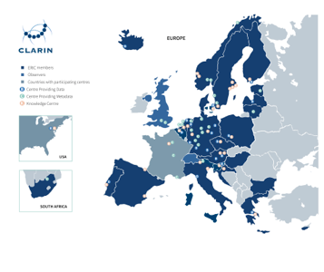
CLARIN today
• 24 members: AT, BE, BG, CY, CZ, DE, DK, EE, ES, FI, GR, HR, HU, IS, IT, LT, LV, NL, NO, PL, PT, SE, SI, ZA
• 2 observers: CH, UK
• 1 Third Party: USA
• > 70 centres
Notes:
This is CLARIN in numbers . More than 70 centers. Countries can be full members or observers; headquarters are located in the Netherlands. Membership is on the basis of annual fees (paid by the Ministries that are members of the General Assembly). The data centers have passed the CLARIN centre assessment procedure and are certified B center and are required to apply for the external CoreTrustSeal certification.

Slide 4
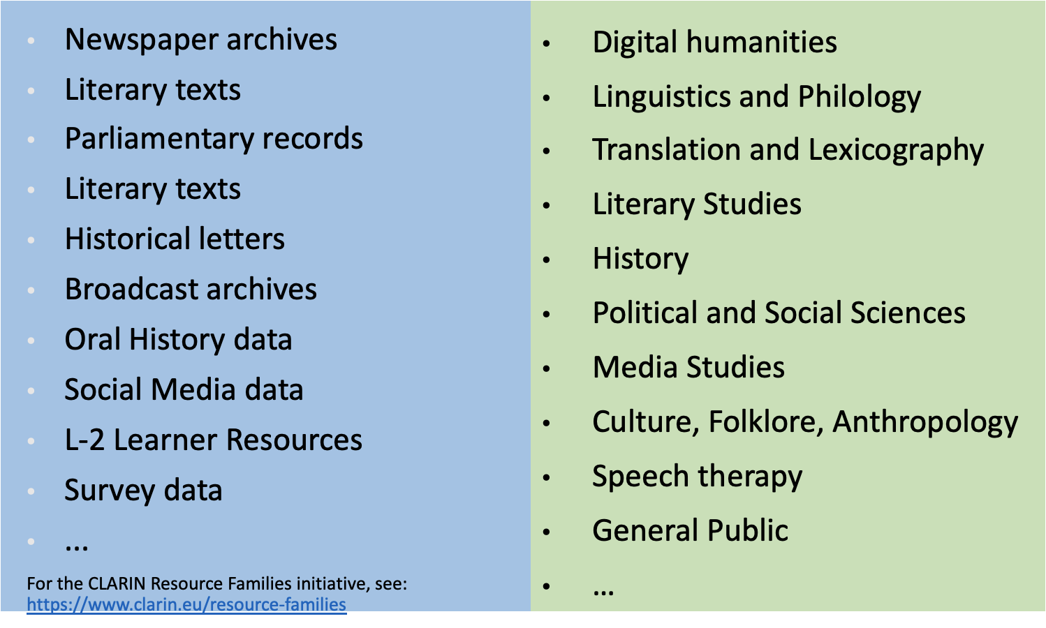
CLARIN data & communities
Notes:
But which data and communities are we speaking about? .... ... Not only Linguists, Philologists, Digital Humanists, but wo also politicians social scientists, psychologists, and as to data not only written modality but also oral and video data.

Slide 5
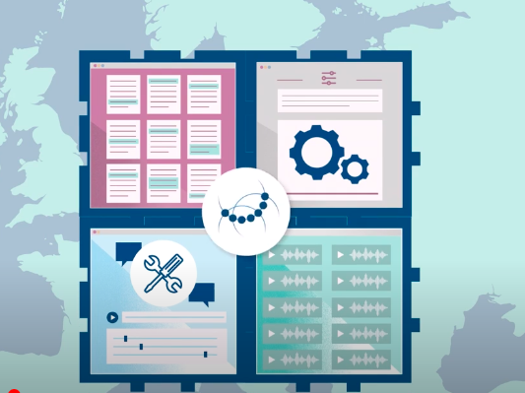
Notes:
The centers all over the federation have same shared protocols, procedures and metadata. These harmonized protocols allow non only to deposit, preserve and access data, but also to combine them with tools and procedures and obtain workflows and "new services", irrespectively where the data is stored and tools exposed.

Slide 6
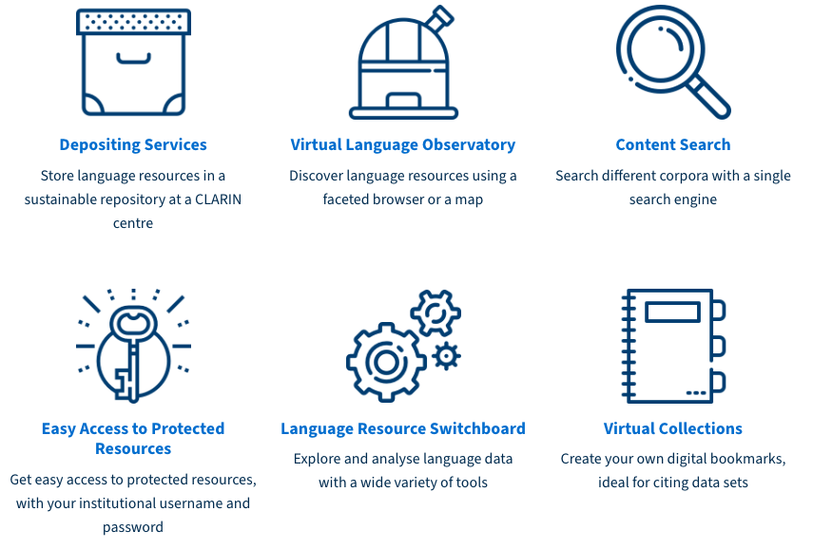
CLARIN – central services
Notes:
CLARIN offers a set of services that are centrally developed and maintained (with the help of national consortia). In particular, the depositing service, the meta-catalogue (virtual language observatory), the language resource switchboard...

Slide 7
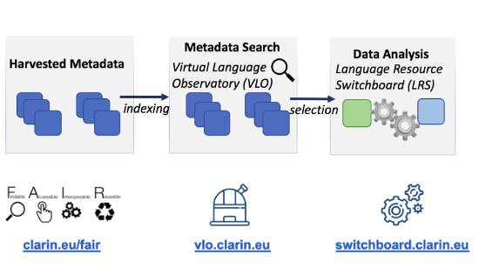
CLARIN – technical infrastructure
Notes:
Just to show a more detailed picture of the process: the procedure of managing data in CLARIN ensures adherence to FAIR principles. Once deposited in a centre the metadata are harvested and indexed in the VLO and from the VLO data is combined with the tools thanks to another service the LRS

Slide 8
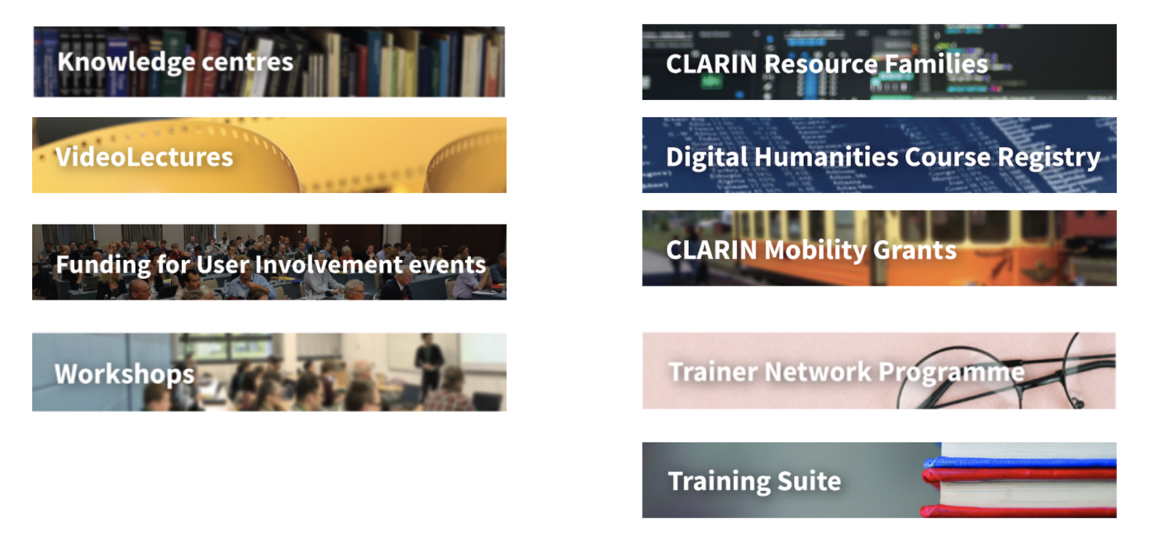
CLARIN – the knowledge infrastructure
Notes:
But CLARIN is also a Knowledge infrastructure, which offers a set of instruments on how to best carry out your research using its services and resources.

Slide 9
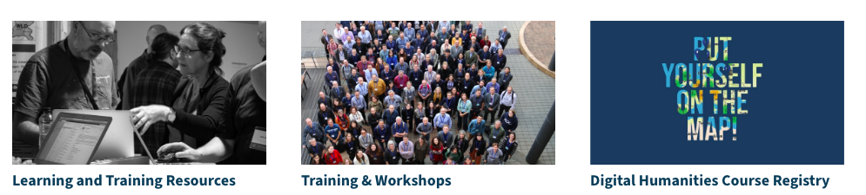
CLARIN Learning & Training
Notes:
CLARIN has also strong interest in training and has developed a set of instruments … a platform of training materials on how to use CLARIN data and tools in daily research practice and how to integrate the infrastructure in classrooms. CLARIN has also organized a platform of special events devoted to hot topics in research. These events are part of the training infrastructure. And … a course registry (together with DARIAH).

Slide 10
CLARIN & Open Science
Promoting the sharing and re-use of data using language resources
Providing datasets available in open access for research purposes
Implementing FAIR data principles
Promoting responsible data science
Supporting for linguistic diversity (more than 1500 languages, tools for many languages, many modalities)
Strengthening the support for SSH researchers (> 500.000 in Europe)
CLARIN: Towards FAIR and Responsible Data Science Using Language Resources." In: Proceedings of the Eleventh International Conference on Language Resources and Evaluation (LREC 2018), May 2018
Notes:
CLARIN moves in the realm of Open Science. CLARIN promoting... providing data in OA for research purposes, implementing FAIR principles, promoting responsible data science, supporting diversity, many languages and many modalities
The Open Science declaration is contained in a programmatic paper

Slide 11

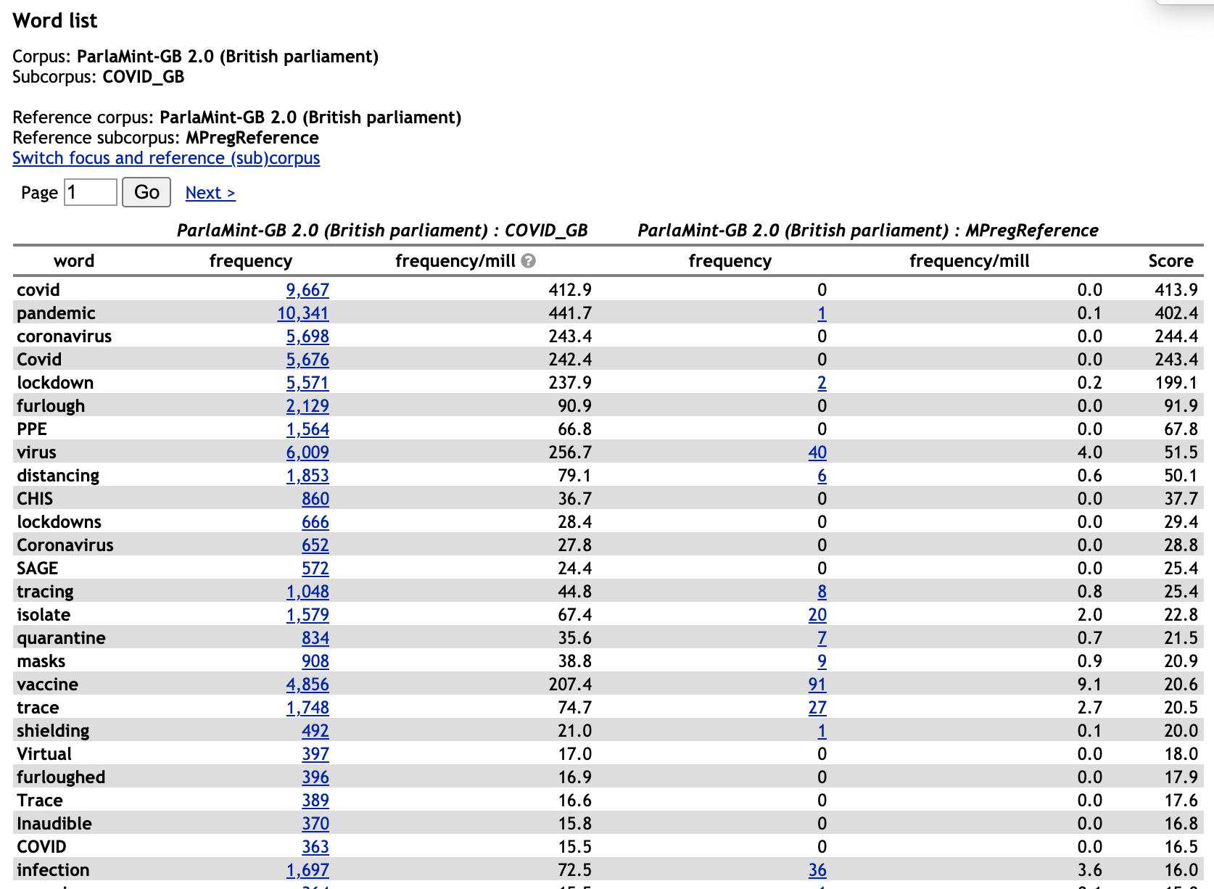
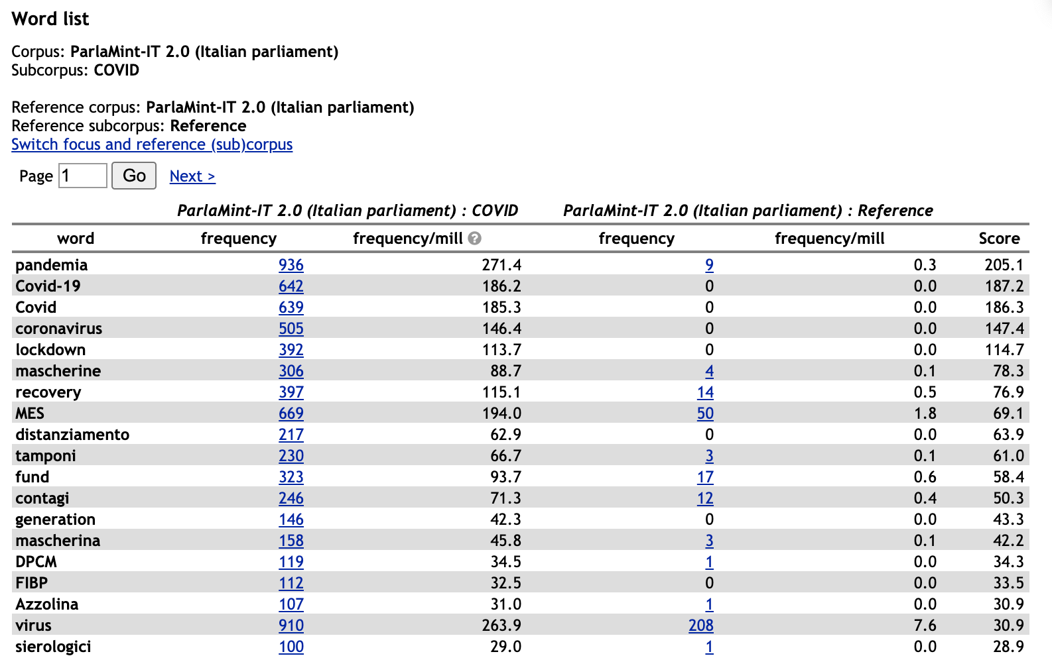
Towards Comparable Parliamentary Corpora
17 European Parliaments
Senate of Italian Republic
Notes:
IMPACT STORIES turned out to be more self explanatory as well as convincing. The case of ParlaMint. It is a flagship project funded by CLARIN, developed by many national consortia, that has built a comparable corpus of data from 17 european parliaments
For example, Parlamint is not only relevant for linguistic investigations but also for political studies and research questions that go beyond language.

Slide 12
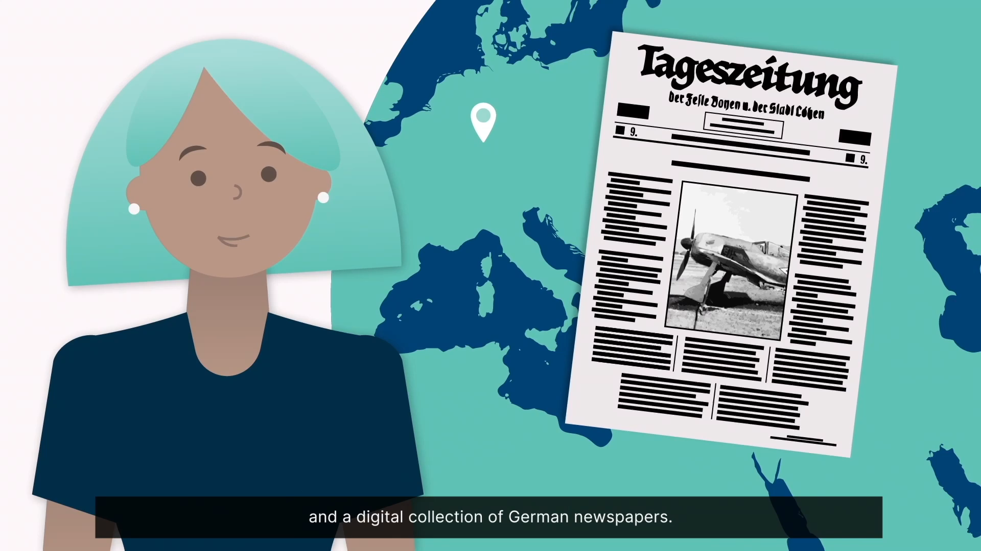
General Meeting 6/7 febbraio 2024

Slide 13
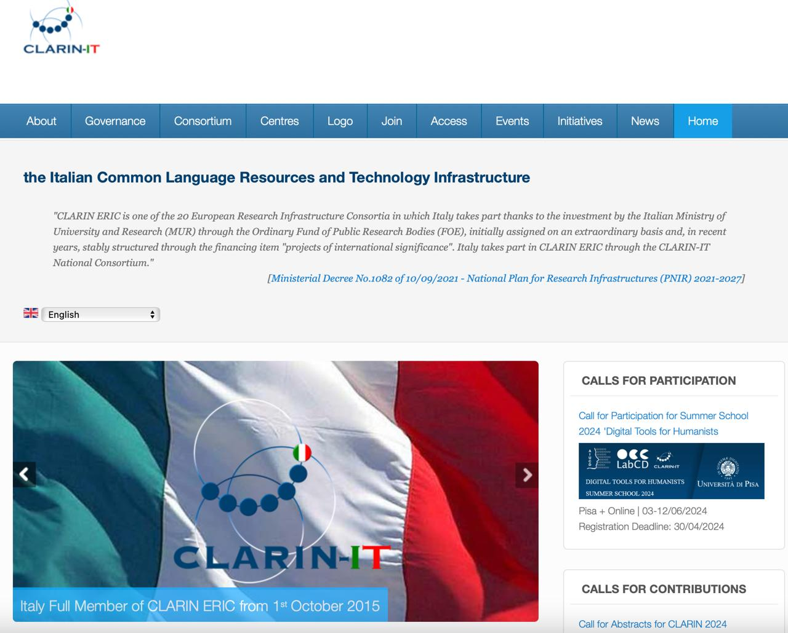




Notes:
Since the 1st of October 2015 Italy is a full member of the CLARIN-ERIC consortium. I principali attori di questa operazione sono il MUR che ha firmato l’adesione, mette a diposizione con il FOE la tassa annuale di adesione, il CNR che attraverso il DSU gestisce le IR nel settore disciplinare e il nostro istututo che grazie al ruolo pioneristico
Nella genesis of this infrastructure, right from its early preparatory stages ha gettato le basi s for the definition of CLARIN [thus playing a strategic role in the process of setting up CLARIN, at the political, organizational, technological and scientific levels]

Slide 14
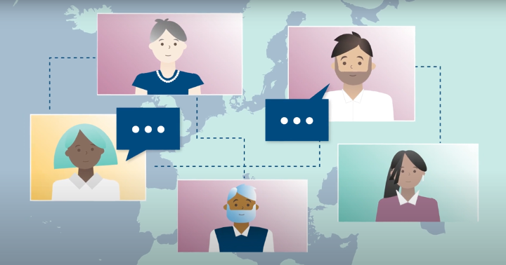
CLARIN-IT
Consortium
General Meeting 6/7 febbraio 2024
Notes:
Consorzio che è It is a network of universities, research centers and institutions bringing together scholars from the Italian community with the aim of ensuring a broad base of developers/creators and users of linguistic resources and technologies; fostering the connection between this field and that of the Humanities and Social Sciences. The network is constantly growing.

Slide 15
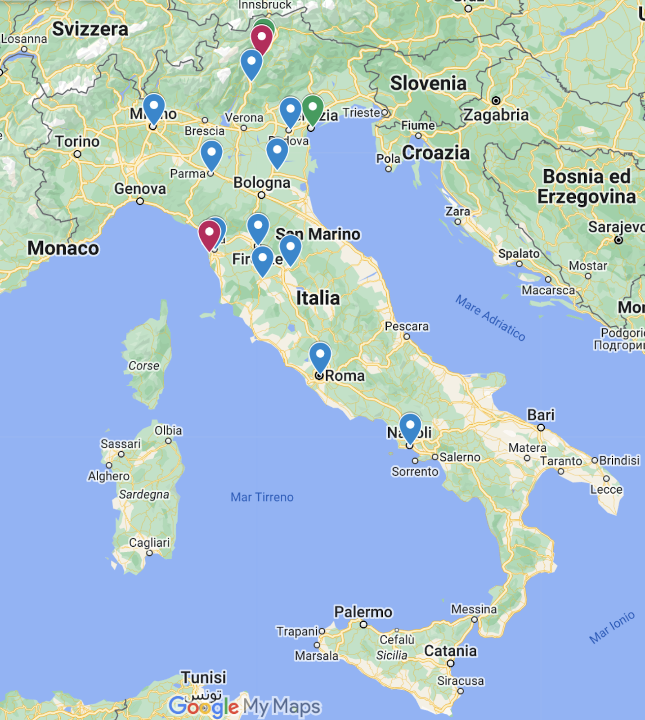
Il consorzio CLARIN-IT
The Department of Philology and Literary Criticism of the University of Siena
The Eurac Research Association (Bolzano)
The Bruno Kessler Foundation (Trento)
The Archival and Bibliographical Superintendence of Tuscany (Firenze)
The Department of Electrical Engineering and
Information Technology and the Interdepartmental
Research Center "URBAN/ECO" of the University of Naples Federico II
The University of Naples L’Orientale
The Catholic University of the Sacred Heart (Milano)
The University of Parma
The University of Padova
Language Center of the University of Ferrara
The RUT Foundation (Rome)
Notes:
Come potete vedere la distribuzione territoriale non solo centri di ricerca ma anche Fondazioni, soggetti interessati alla salvaguardia e alla condivisione di risorse e strumenti a garanzia the FAIR principles of open science (vedremo dopo).

Slide 16
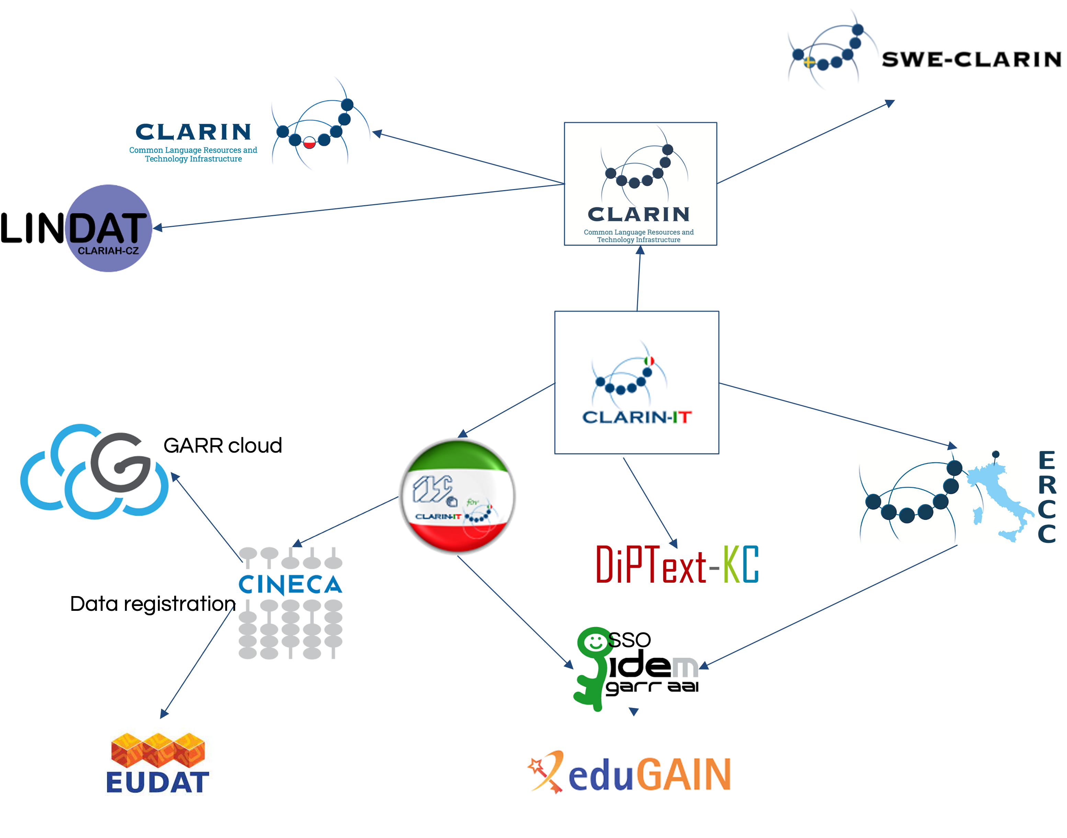
Notes:
Al cuore del consorzio risiede il centro ILC4CLARIN data center, implementato a Pisa and supported dal repository che opera presso EURAC in Bolzano. Il centro italiano è affiancato da un centro competenze che offre consulenza su questioni di ricerca legate all’analisi del testo. ILC4CLARIN è tra i pochi che offer certificazione concessa da una entità esterna, CoreTrustSeal certification.
Oggi con l’accento of the open science paradigm, molte università affidano I loro dati a institutional open repositories.

Slide 17
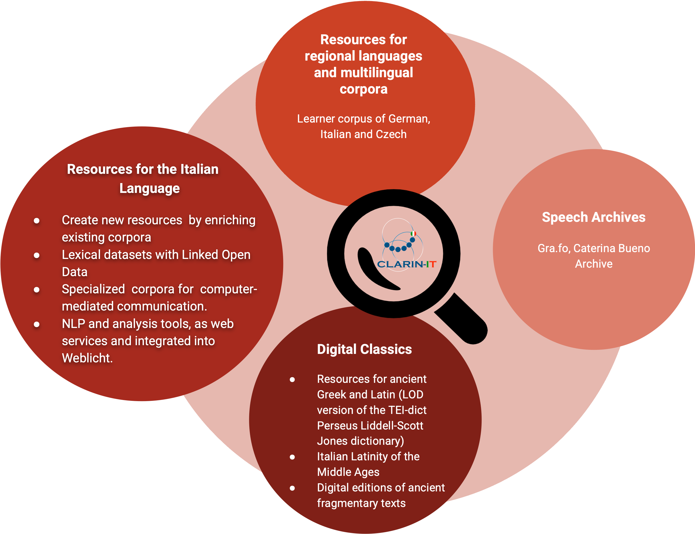
Direzioni di ricerca
General Meeting 6/7 febbraio 2024
Notes:
Brevemente le direzioni di ricerca. La comunità italiana che si raccoglie attorno a CLARIN ha consentito di sviluppare line di ricerca dedicate al ciclo di vita delle di risorse per l’italiano, ma non solo abbiamo anche risorse per le lingue classiche con un filone di ricerca delle Digital Classics … e questo è un bene perché è un settore difficile da raggiungere sempre reteicente all’applicazione di metodi digitali nelle pratiche di studio. Ed infine linea di ricerca particolarmente a fuoco oggi, gli archivi orali

Slide 18
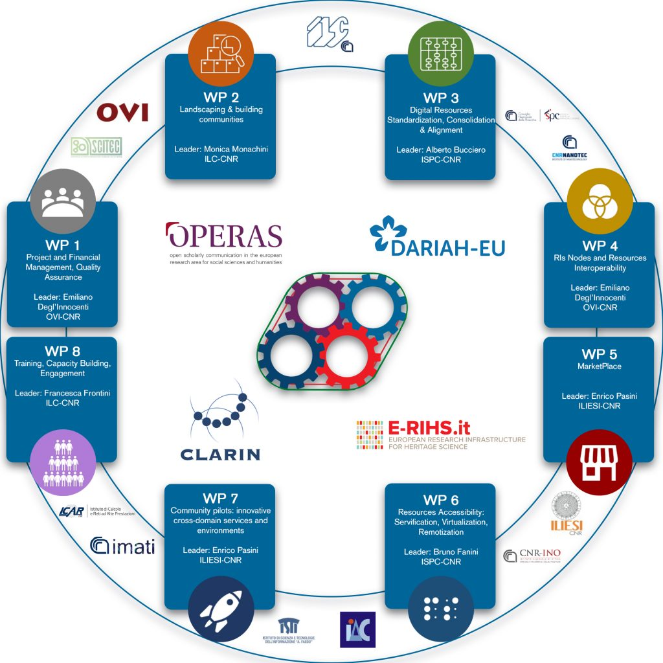
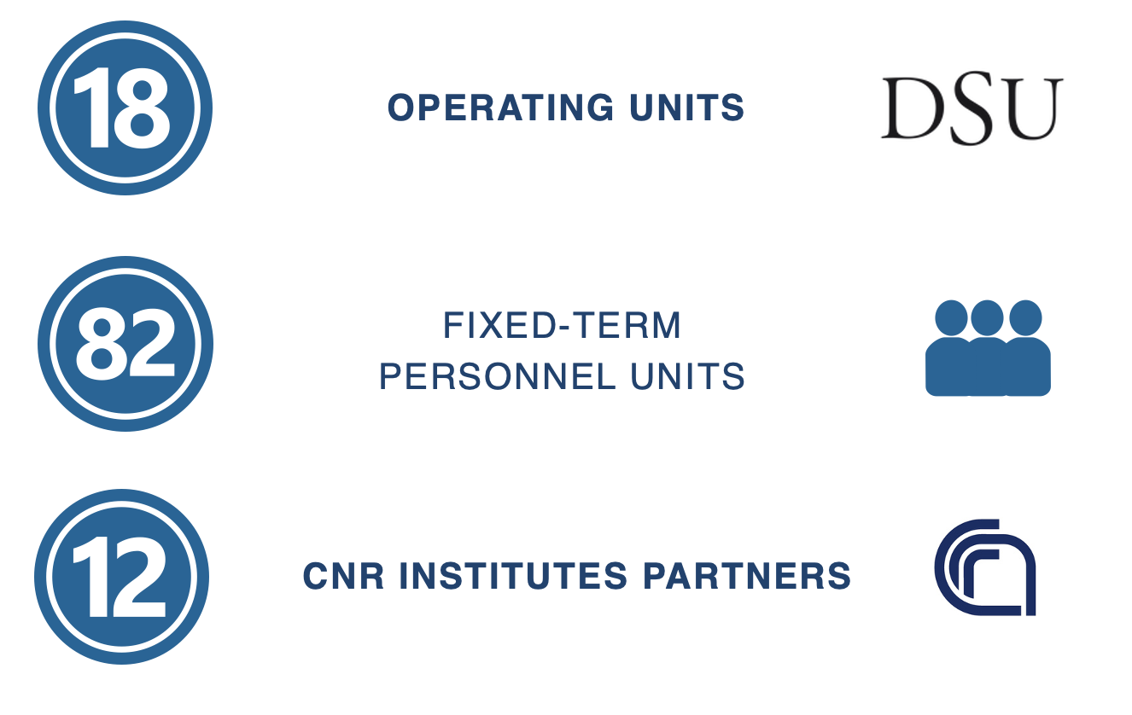
NAPOLI (DARIAH, OPERAS, E-RIHS)
LECCE (DARIAH, E-RIHS)
PISA (DARIAH, CLARIN)
ROMA (DARIAH, E-RIHS, OPERAS)
CATANIA (DARIAH, E-RIHS)
MILANO (E-RIHS)
FIRENZE (E-RIHS, DARIAH)
GENOVA (E-RIHS)
Notes:
CLARIN-IT, come IR High priority del PNIR, ha ricevuto fondi per il potenziamento grazie al PNRR e il progetto H2IOSC che mira a federare 4 IR del settore Social Cultural Innovation a trazione CNR, grazie alla messa a fattor comune di esperienze metodi servizi delle infra coinvolte (alla stregua di esperienze a liv europeo nei progetti INFRA EOSC come SSHOC). Potete vedere I numeri del progetto, le sedi CNR coinvolte .

Slide 19
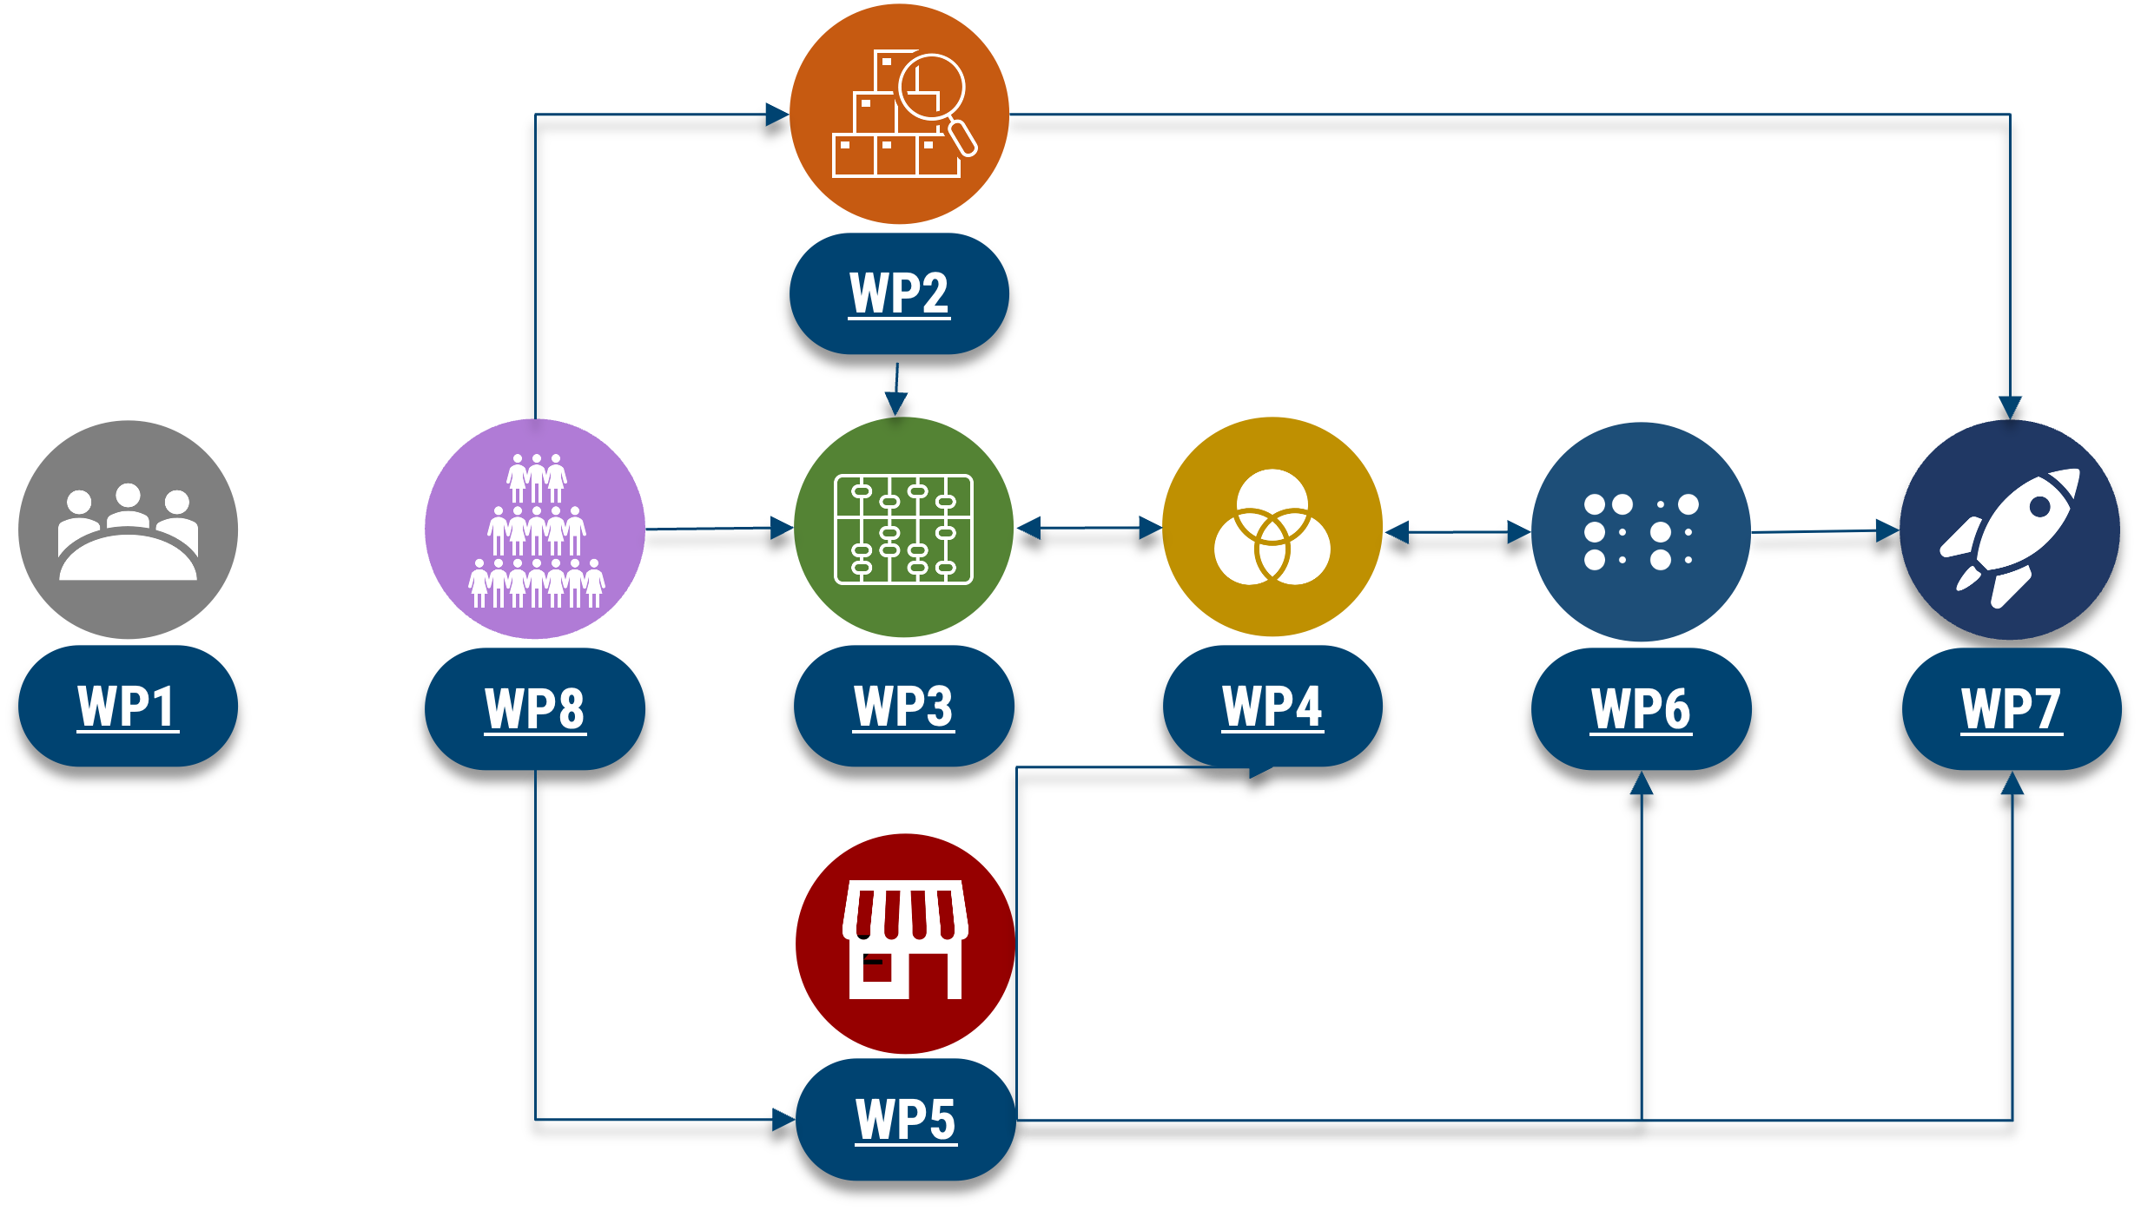
Notes:
Accenno al potenziamento

Slide 20





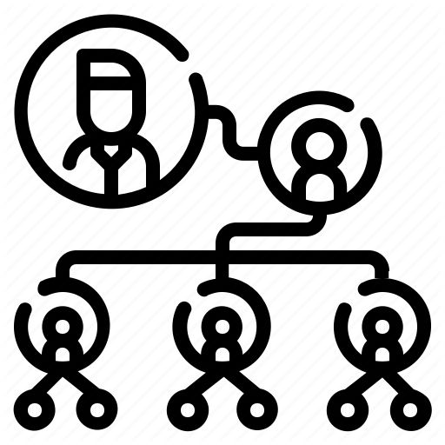

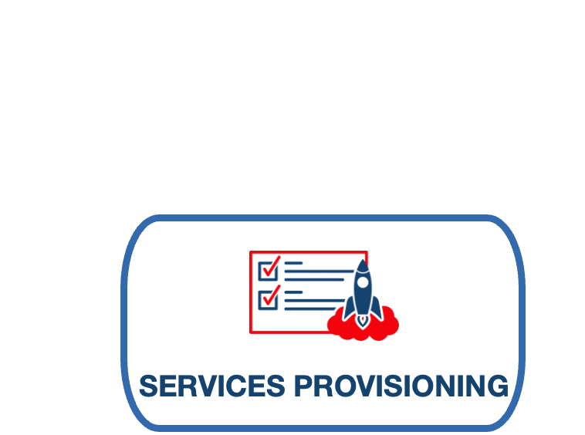

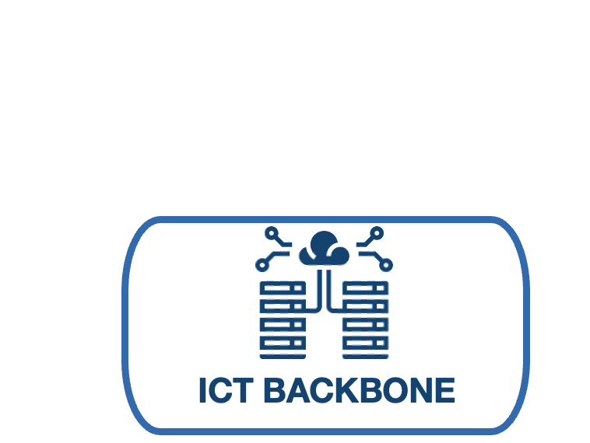
WP1
WP4
WP2
WP3
STAKEHOLDERS
&
SUSTAINABILITY
KNOWLEDGE
ORGANIZATION
SEMANTICS
WP5
WP8
WP7
WP6
MANAGEMENT
Notes:
Il potenziamento avviene attraverso un flusso di lavoro qui sintetizzato che va dalla mappatura delle risorse, alla messa a fattor comune di servizi, dimostratori, con una forte vocazione alla fairificazione interoperabilità, il tutto esposto in un cloud virtuale che è il market place, e una attenzione verso la formazione.

Slide 21
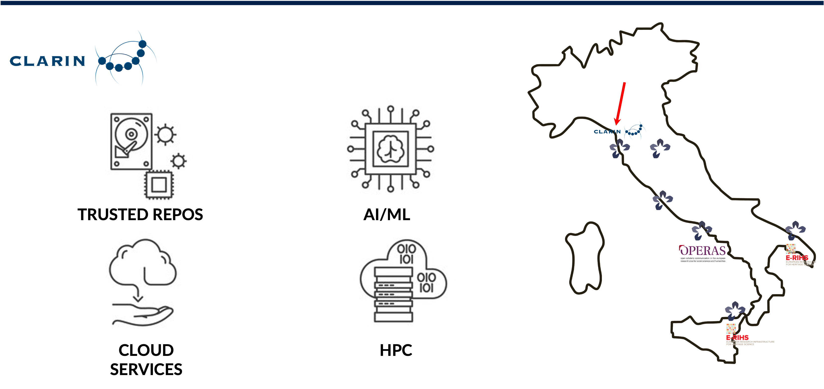
Notes:
Il potenziamento passa attraverso la costituzione di una intelaiatura di data center

Slide 22
General Meeting 6/7 febbraio 2024
Notes:
La federazione CLARIN condivide protocolli armonizzati e metadati, ciò consente di usare in modo creativo diversi tipi di dati e strumenti presenti nei vari nodi della IR
Ora si introducono i servizi principali a cui poter accedere tramite CLARIN-IT.

Slide 23
CLARIN – servizi centrali
General Meeting 6/7 febbraio 2024
Notes:
CLARIN offers a set of services that are centrally developed and maintained (with the help of national consortia). In particular, the depositing service, the meta-catalogue (virtual language observatory), the language resource switchboard, la ricerca federata di contenuto

Slide 24
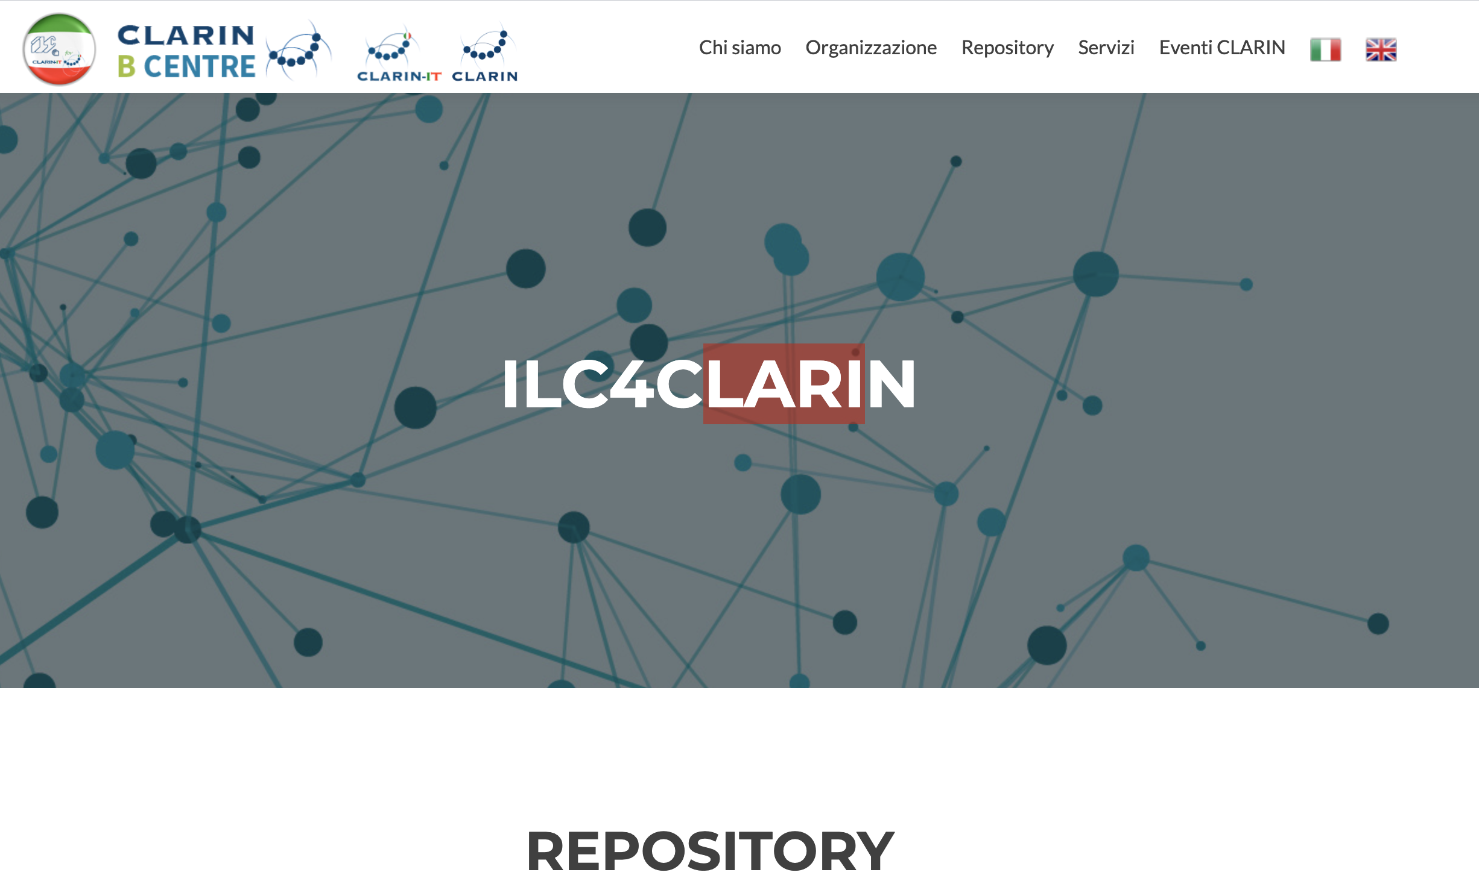
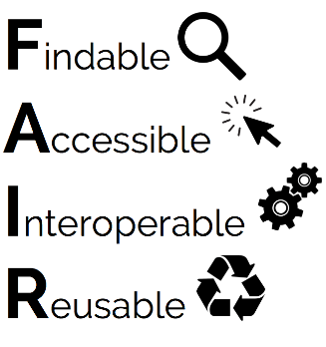
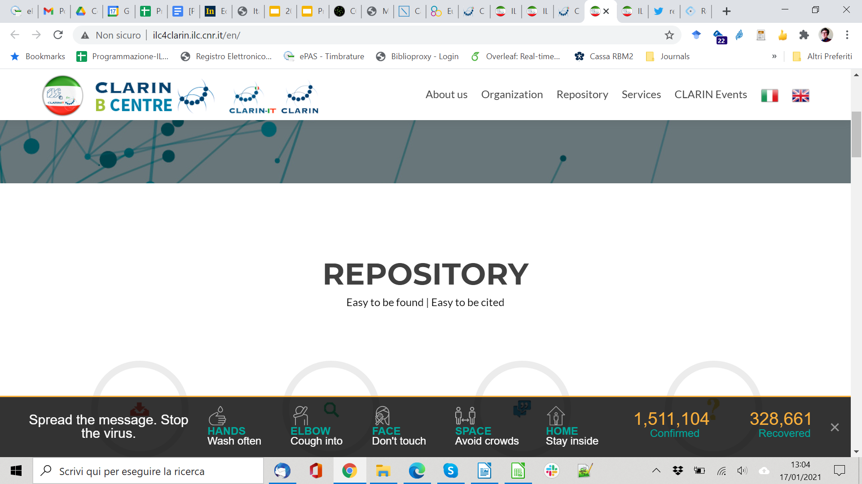
ILC4CLARIN: repository
For more see: https://dspace-clarin-it.ilc.cnr.it/repository/xmlui/
Notes:
Questo è il nostro repository. Permette di deposito di diversi tipi di risorse garantendo la long term preservation e la descrizoine dei dati secondo I principi fair. Vediamo come

Slide 25

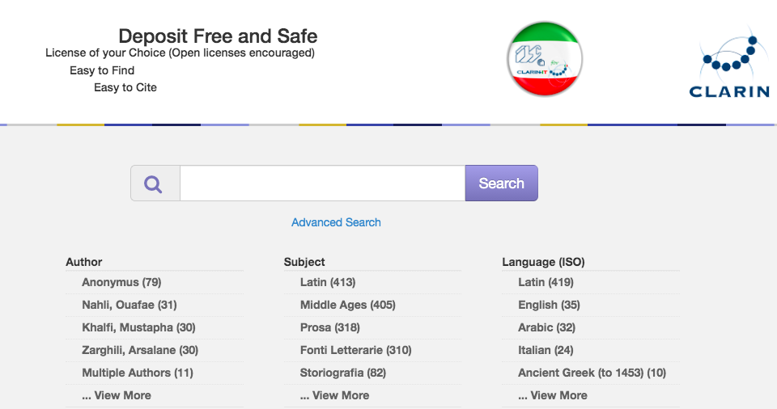
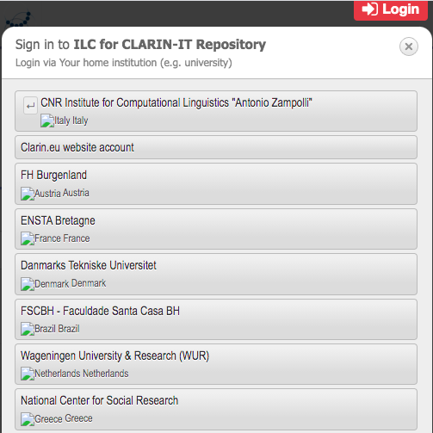
For more see: https://www.clarin.eu/content/federated-identity
Notes:
per depositare ci si connette con le credenziali istituzionali

Slide 26

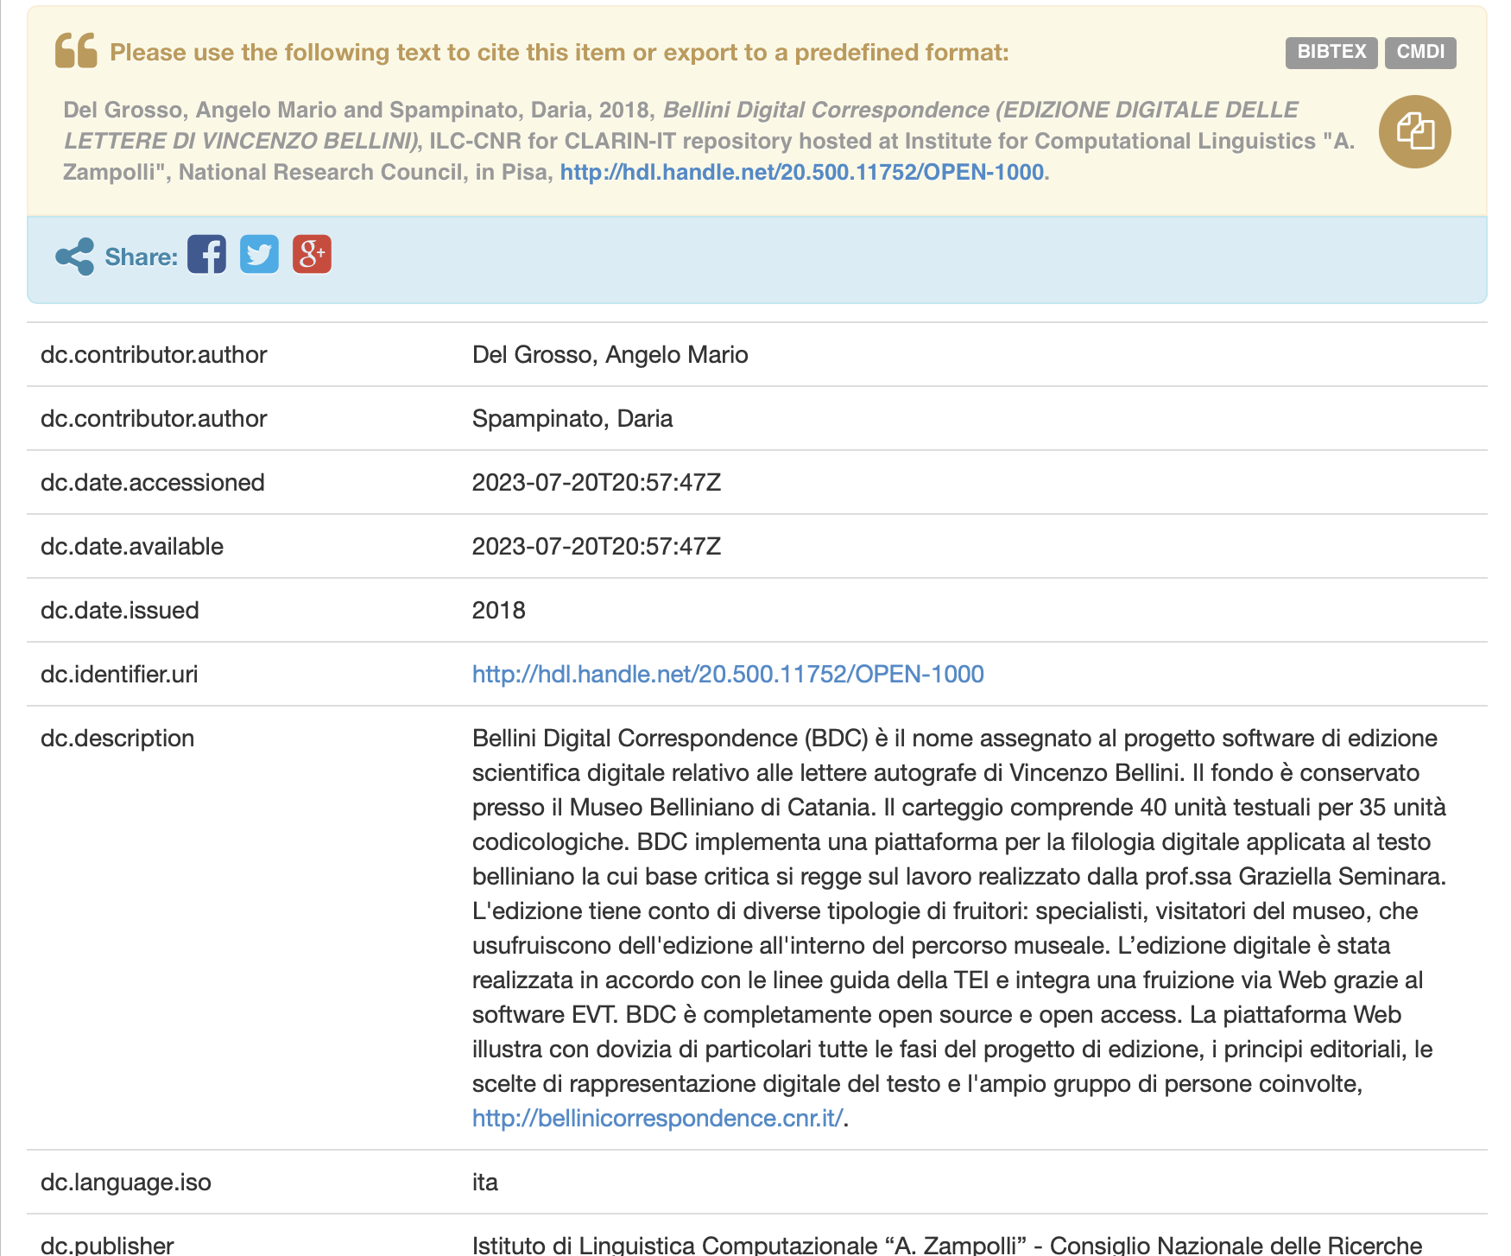
ILC4CLARIN: descrivere, identificare e citare
For more see: https://www.clarin.eu/content/persistent-identifiers
Notes:
Una flusso guidata e un interfaccia intuitiva consente il deposito e l’attribuzione dei MD durante le fasi di deposito.
Questo è cio che si vede lato utente per I metadati a garanzia della ricercabilità

Slide 27

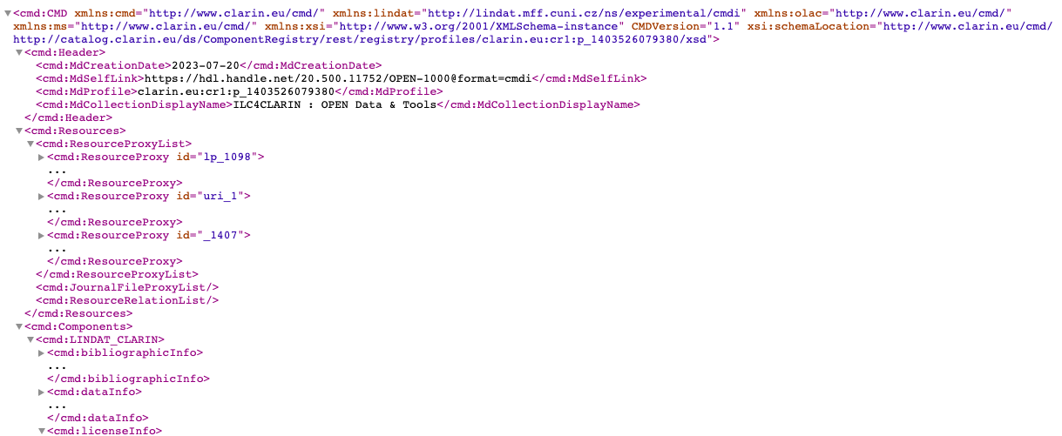
ILC4CLARIN: metadati
For more see: https://www.clarin.eu/content/cmdi-component-metadata-infrastructure
Notes:
E questo invece Lato “macchina” è l’esposizione dei MD in XML per consentire harvesting tramite protocollo OAIPMH a garanzia della interoperabilità…

Slide 28

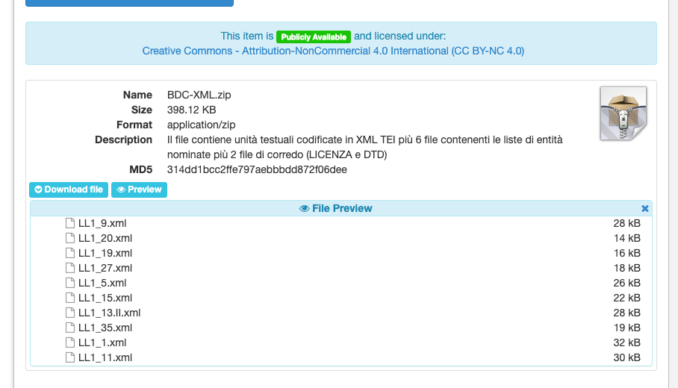
ILC4CLARIN: condividere
For more see: https://www.clarin.eu/content/licenses-and-clarin-categories
Notes:
Sempre le procedure di deposito consentono di imporre licenze e quindi di condividere i dati in maniera appropiriate secondo I desiderata dei proprietari/depositatori

Slide 29

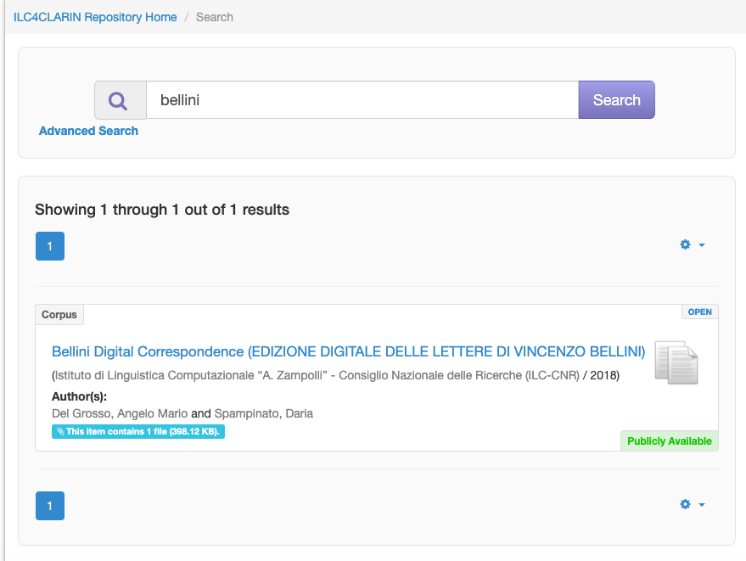
ILC4CLARIN: accedere da un centro nazionale
Notes:
Quindi per un utente le possibilità di ricerca e accesso ai dati avvengono attraverso due vie principali: il repository nazionali (se uno conosce dove siano depositati I dati) oppure

Slide 30

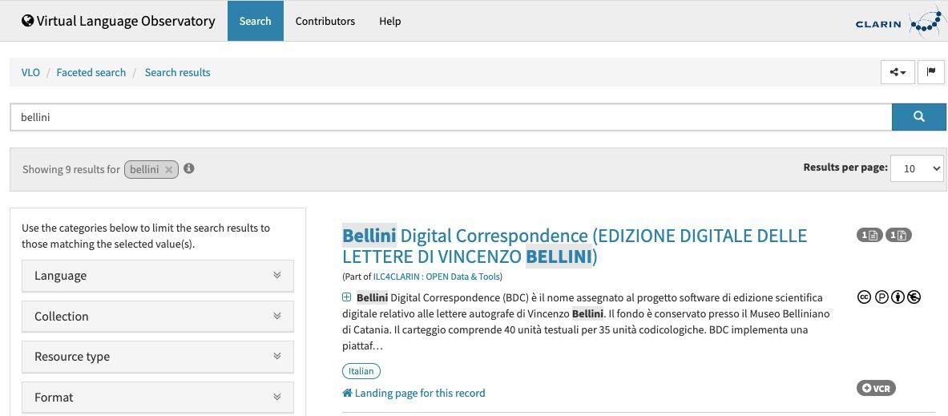
CLARIN VLO: accedere dal meta catalogo
For more see: https://www.clarin.eu/content/virtual-language-observatory-vlo
Notes:
Oppure il VLO. Abbiamo visto infatti come, dopo il deposito, ci sia un protocollo di esposizione e raccolta metadati che proietta I MD nei META CATALOGO internazionale, massimaizzando e garantendo visibilità ai dati.

Slide 31

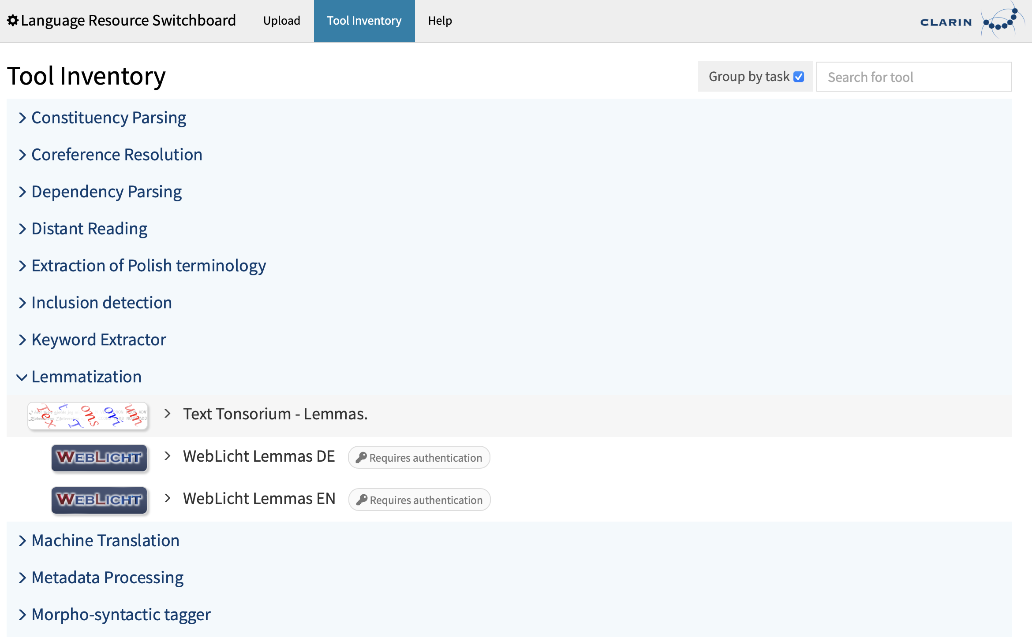
Servizi avanzati: connettere dati-strumenti
For more see: https://www.clarin.eu/content/language-resource-switchboard
Notes:
Ma non solo dati… CLARIN come abbiamo detto, consente anche di trovare strumenti adatti ad operare sui dati, ad analizzare i dati. Si puö quindi accedere al LRS e caricare dei dati da dare in pasto agli strumenti di analisi linguistica oppure in caso si cerchi un tool in particolare (come per questo caso un lemmatizzatore), si può andare nella funzione inventario dei tool e ricercare cosa di cui abbiamo bisogno.

Slide 32

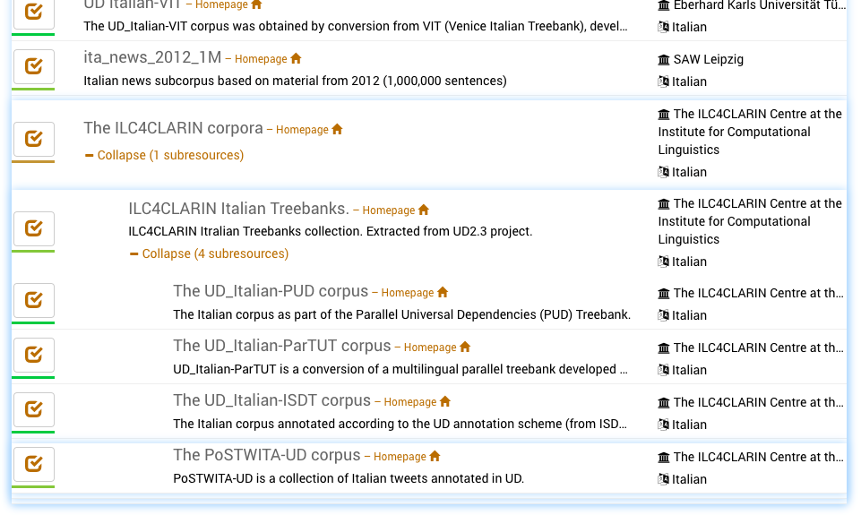
CLARIN: ricerca federata di contenuto
For more see: https://www.clarin.eu/content/federated-content-search-clarin-fcs-technical-details

Slide 33
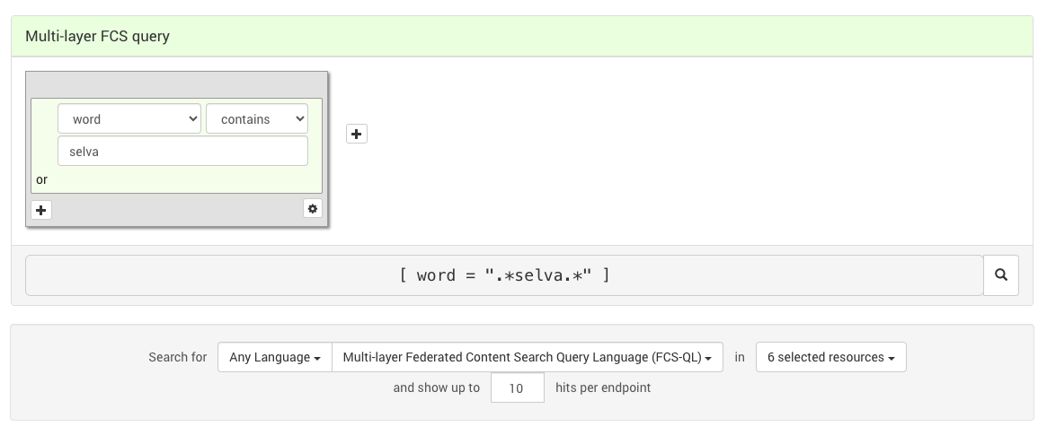
CLARIN: Ricerca federata di contenuto

Slide 34
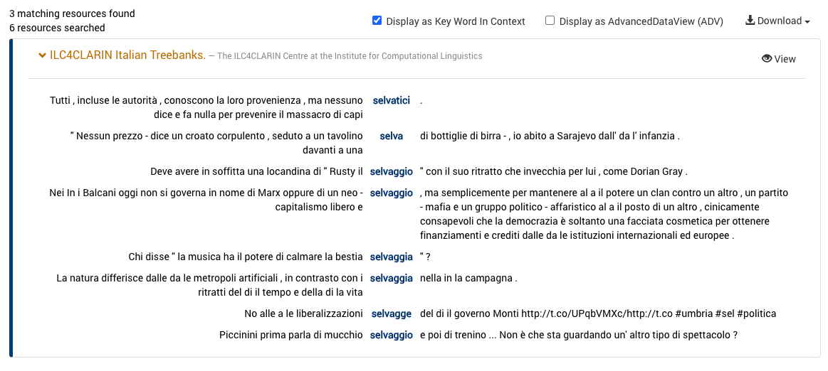
Ricerca federata di contenuto

Slide 35
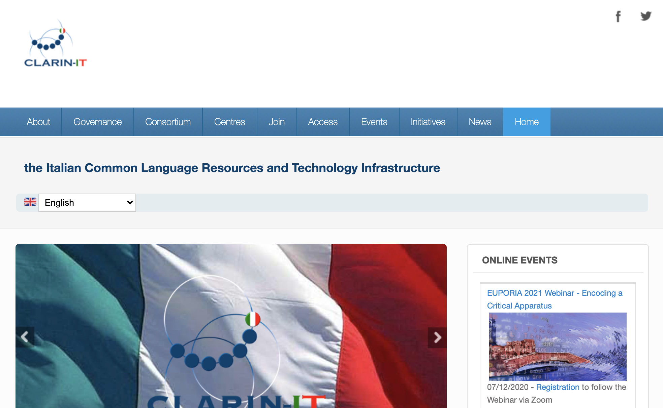
Notes:
Since the 1st of October 2015 Italy is a full member of the CLARIN-ERIC consortium. Italy has historically played a pioneering and strategic role in the genesis of this infrastructure, right from its early preparatory stages, with the participation of the CNR and the involvement of our institute in a pilot study that laid the foundations for the definition of CLARIN [thus playing a strategic role in the process of setting up CLARIN, at the political, organizational, technological and scientific levels]

Slide 36
CLARIN-IT
Consortium
General Meeting 6/7 febbraio 2024
Notes:
An overview of the Italian CLARIN-IT consortium. It is a network of universities, research centers and institutions bringing together scholars from the Italian community with the aim of ensuring a broad base of developers/creators and users of linguistic resources and technologies; fostering the connection between this field and that of the Humanities and Social Sciences. The network is constantly growing.

Slide 37
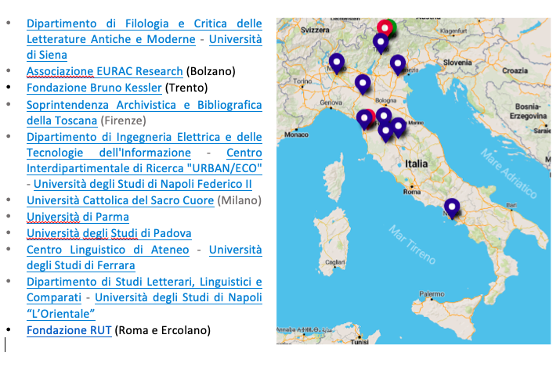
CLARIN IT consortium
Notes:
t is a network of universities, research centers and institutions bringing together scholars from the Italian community with the aim of ensuring a broad base of developers/creators and users of linguistic resources and technologies; fostering the connection between this field and that of the Humanities and Social Sciences. The network is constantly growing.

Slide 38
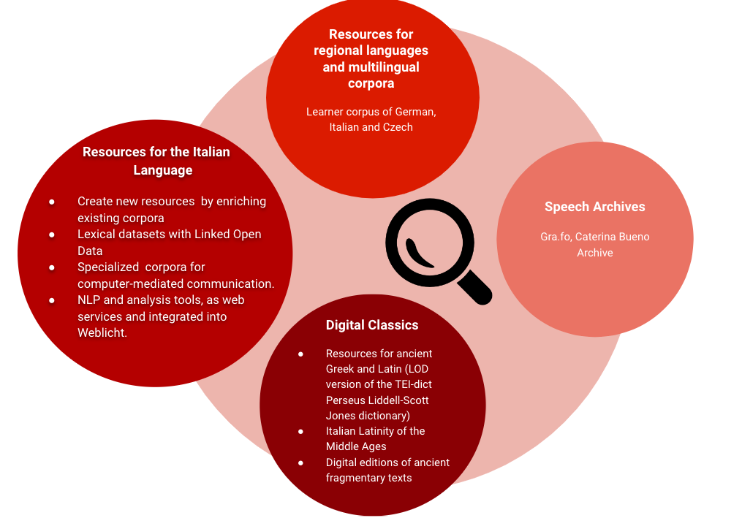
Research Directions
Notes:
A brief overview of the research directions within the consortium.
CLARIN-IT offers a wide range of language resources with language analysis tools.
We are experts in language resource enrichment and publishing according to new models and formats.
There are also multilingual corpora for learners in regions in contact; on language studies in the computer and social age, one strand of research focuses on the side of Oral Archives; the area Digital Classics, with the application of digital concepts and methods to classical language studies (a field that is sometimes reticent to adopt such paradigms)

Slide 39
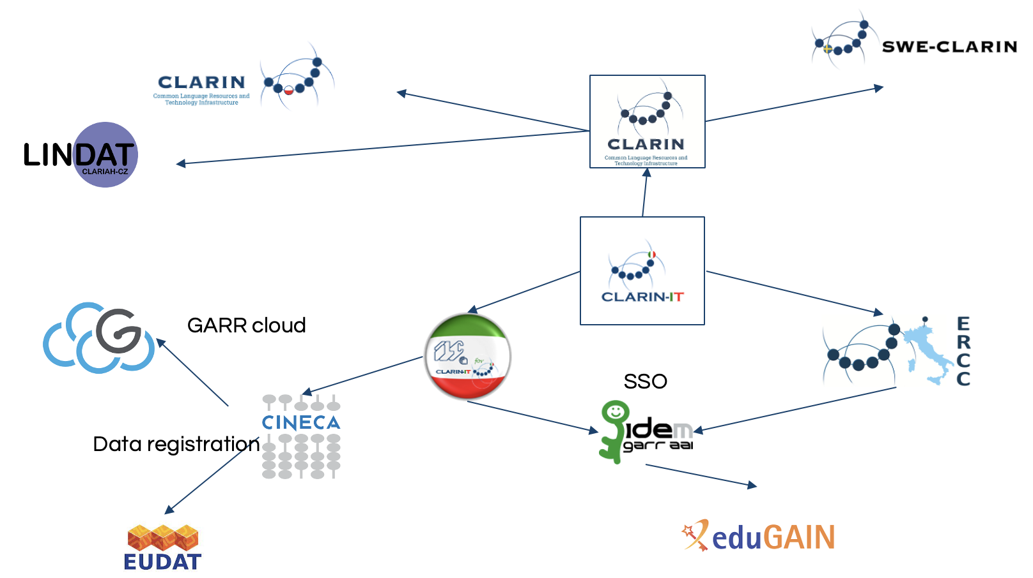
CLARIN-IT – technological infrastructure
Notes:
At the heart of the national CLARIN consortium there is the ILC4CLARIN data center, implemented in Pisa and supported by a metadata repository at the research center operating at EURAC in Bolzano. Today, with the emergence of the open science paradigm, many Italian universities feel the need to entrust their data to institutional open repositories, and among the centers currently active in Italy, ILC4CLARIN is among the only few with certification provided by an external entity. ILC4CLARIN offers data preservation and services to guarantee the FAIR principles of open science, findability and persistence interoperability and secure access.

Slide 40
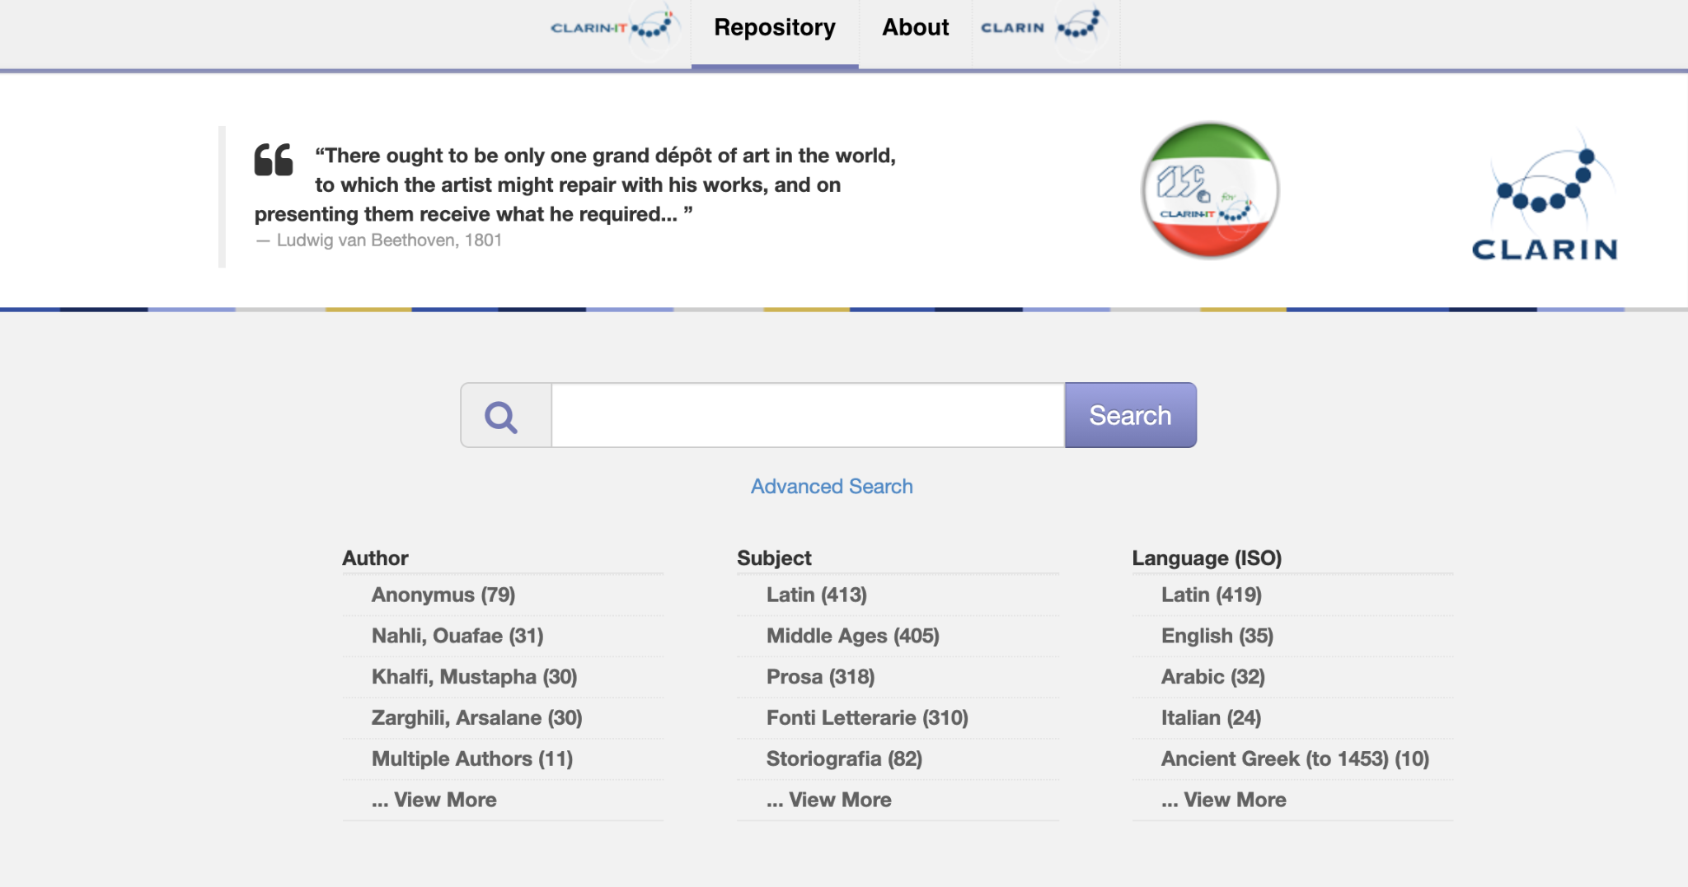
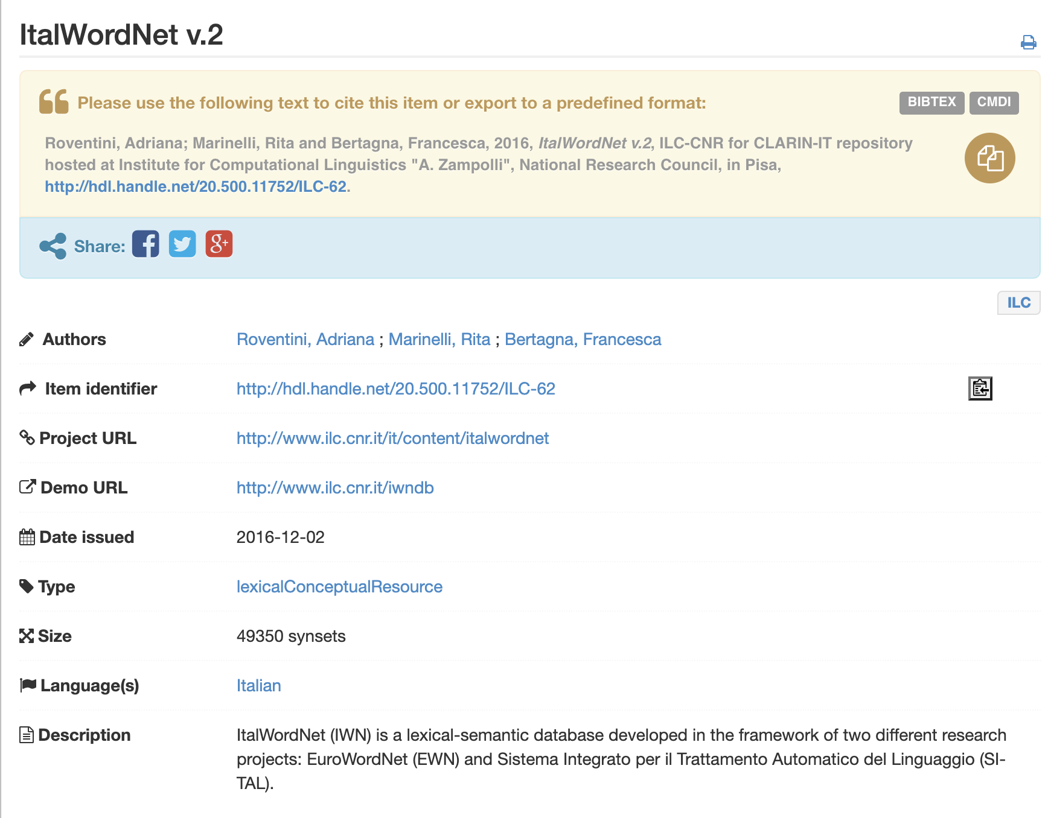
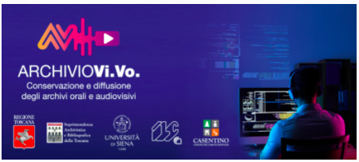
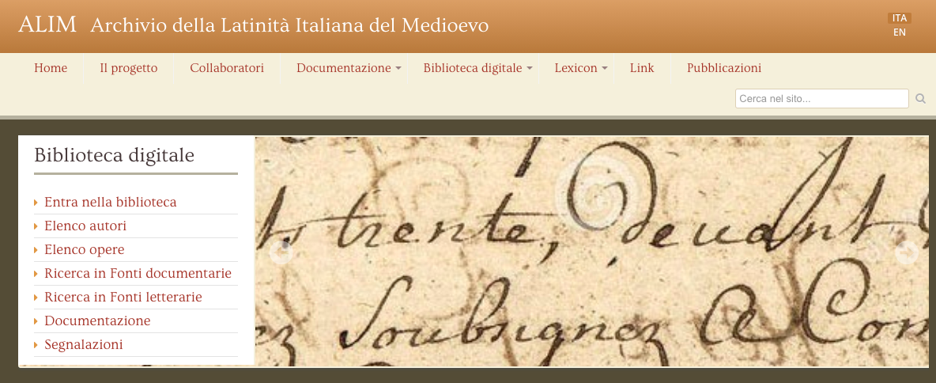
Notes:
The repository hosts the heritage developed over the years by the Institute through collaborations with universities and national cultural institutions: archives of inestimable historical, linguistic and literary value, as well as lexical and textual resources enriched with linguistic information.
The archives at risk of obsolescence have been joined by resources developed both by the Institute and by the national Humanities and Social Sciences (SSH) community, which, while not at immediate risk, have been brought into conformity with FAIR principles to be shared with the scholarly community, enhanced and safeguarded. Today, our repository hosts data archives for the Italian language and classical languages. Archives from written but also oral sources

Slide 41


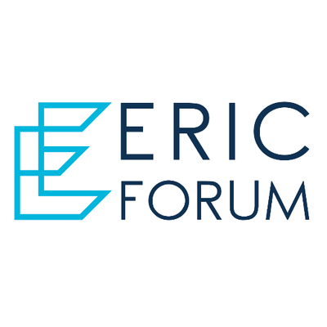


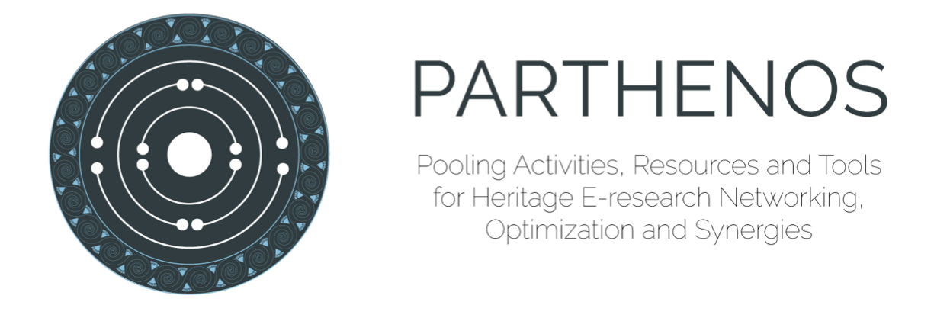
CLARIN involvement in H2020 projects
General Meeting 6/7 febbraio 2024
Notes:
Andrò quindi ad illustrare brevemente [leggere slide]

Slide 42

CLARIN ILC Data Center
Notes:
Per venire incontro alla domanda di servizi e per offrire servizi avanzati alla comunità e per potenziare l'infrastruttura di ricerca CLARIN, lo scorso anno, siamo stati selezionati per l’assegnazione dei fondi strutturali per il potenziamento delle infra che sono transitati al CNR dal MEF nel biennio 21-22 … destinatiall la costruzione del data center di CLARIN-IT. Una volta che saranno completate le opere di adeguamento degli impianti, l’AdR ospiterà una infrastruttura tecnologica avanzata con elevate capacità di calcolo e di storage per favorire attività di analisi di big data deep learning e long term preservation.

Slide 43
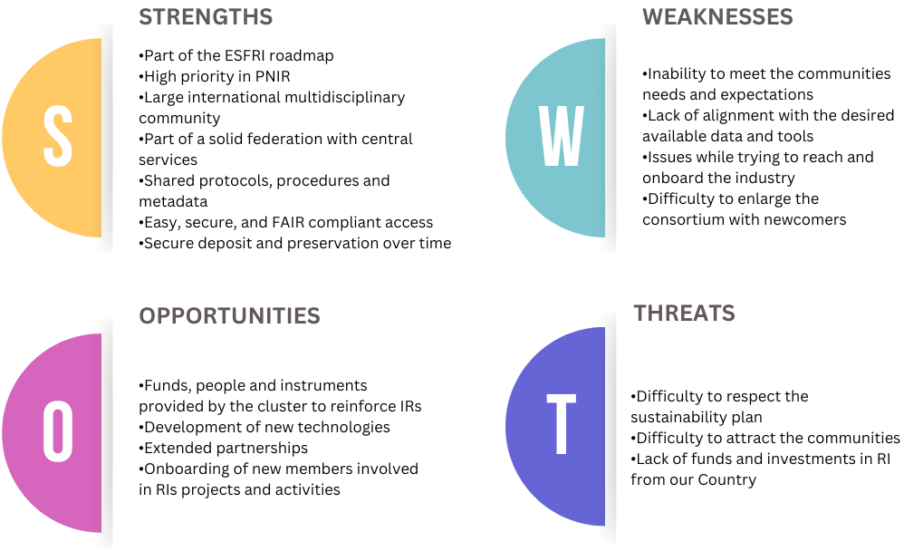
SWOT analysis
General Meeting 6/7 febbraio 2024
Notes:
TO CONCLUDE this overview. Which is the main contribution of clarin to the project? And which are the mutual relationships. We tried to answer in terms of swot analysis. And this is the list of main strong and weak points that I see, the main opportunities offered by h2iosc and some threats coming from outside.

Slide 44
STRENGTHS | Addedd value for H2IOSC
Maturity: ERIC ('12); ESFRI Landmark ('16); PNIR (2022-'27) | Experience and competence in ERIC governance
Central FAIR services (deposit, access, find, compose) | Set of ready to use services for the Marketplace
Harmonized Protocols | Best practices for the Marketplace
General Meeting 6/7 febbraio 2024
Notes:
Here I'd like to provide some food for thoughts. CLARIN main strong points are a good maturity level in ERIC and this offers to the h2iosc consortium great experience and competence in governance. We have developed central services based on fair approach and harmonized protocols that are crucial for the services of the marketplace

Slide 45
WEAKNESSES | Opportunities from H2IOSC
Reach the entire target research community; include new comers in the consortium | Extended partnership: synergies and involvement; increase fund raising
Onboard the industry | Developing attractive services
Alignment demand-offer of available data and tools | Developing new technologies
Sustain the IR | Funds, people, instruments to reinforce the IR; sustainaibility for next 10 years
General Meeting 6/7 febbraio 2024
Notes:
As concerns the weak points, these concern the engament with the community, in terms of reaching the community at large, include new comers in the consortium, engage with industry and the opportunities offered by h2iosc are very important here with the extended parternership and the possibility to increase synergies, and last but not least increase the opportunity of fund raising. Funds people and instruments offered by h2iosc will be beneficial to develop new technology and attractive services and to help to align offer and demand in terms of data and tools.

